Slide 1
BIGMART SALES PREDICTION USING MACHINE LEARNING
ABSTRACT
Now a days many shopping malls keep track of individual item sales data in order to forecast future client demand and adjust inventory management. In order to be ahead of the competition and earn more profit one needs to create a model which will help to predict and find out the sales of the various product present in the particular store. So to predict out the sales for the big mart one need to use the very important tool i.e. Because of increasing competition among various shopping complex one needs to have some predictive model which could help to gain some useful insights so as to maximize the profit and be ahead of the competitors.

Slide 2
  PROBLEM STATEMENT
Due to increasing competition many malls and big mart are trying their best to stay ahead in competition. In order to find out what are the various factors which affect the sales of big mart and what strategies one needs to employ in order to gain more profit one need to have some model on which they can rely .
So a predictive model can be made which could help to gain useful information and increase profit.
OBJECTIVES
Predicting future sales from a given dataset.
To understand the key features that are responsible for the sale of a particular product.
Find the best algorithm that will predict sales with the greatest accuracy.

Slide 3
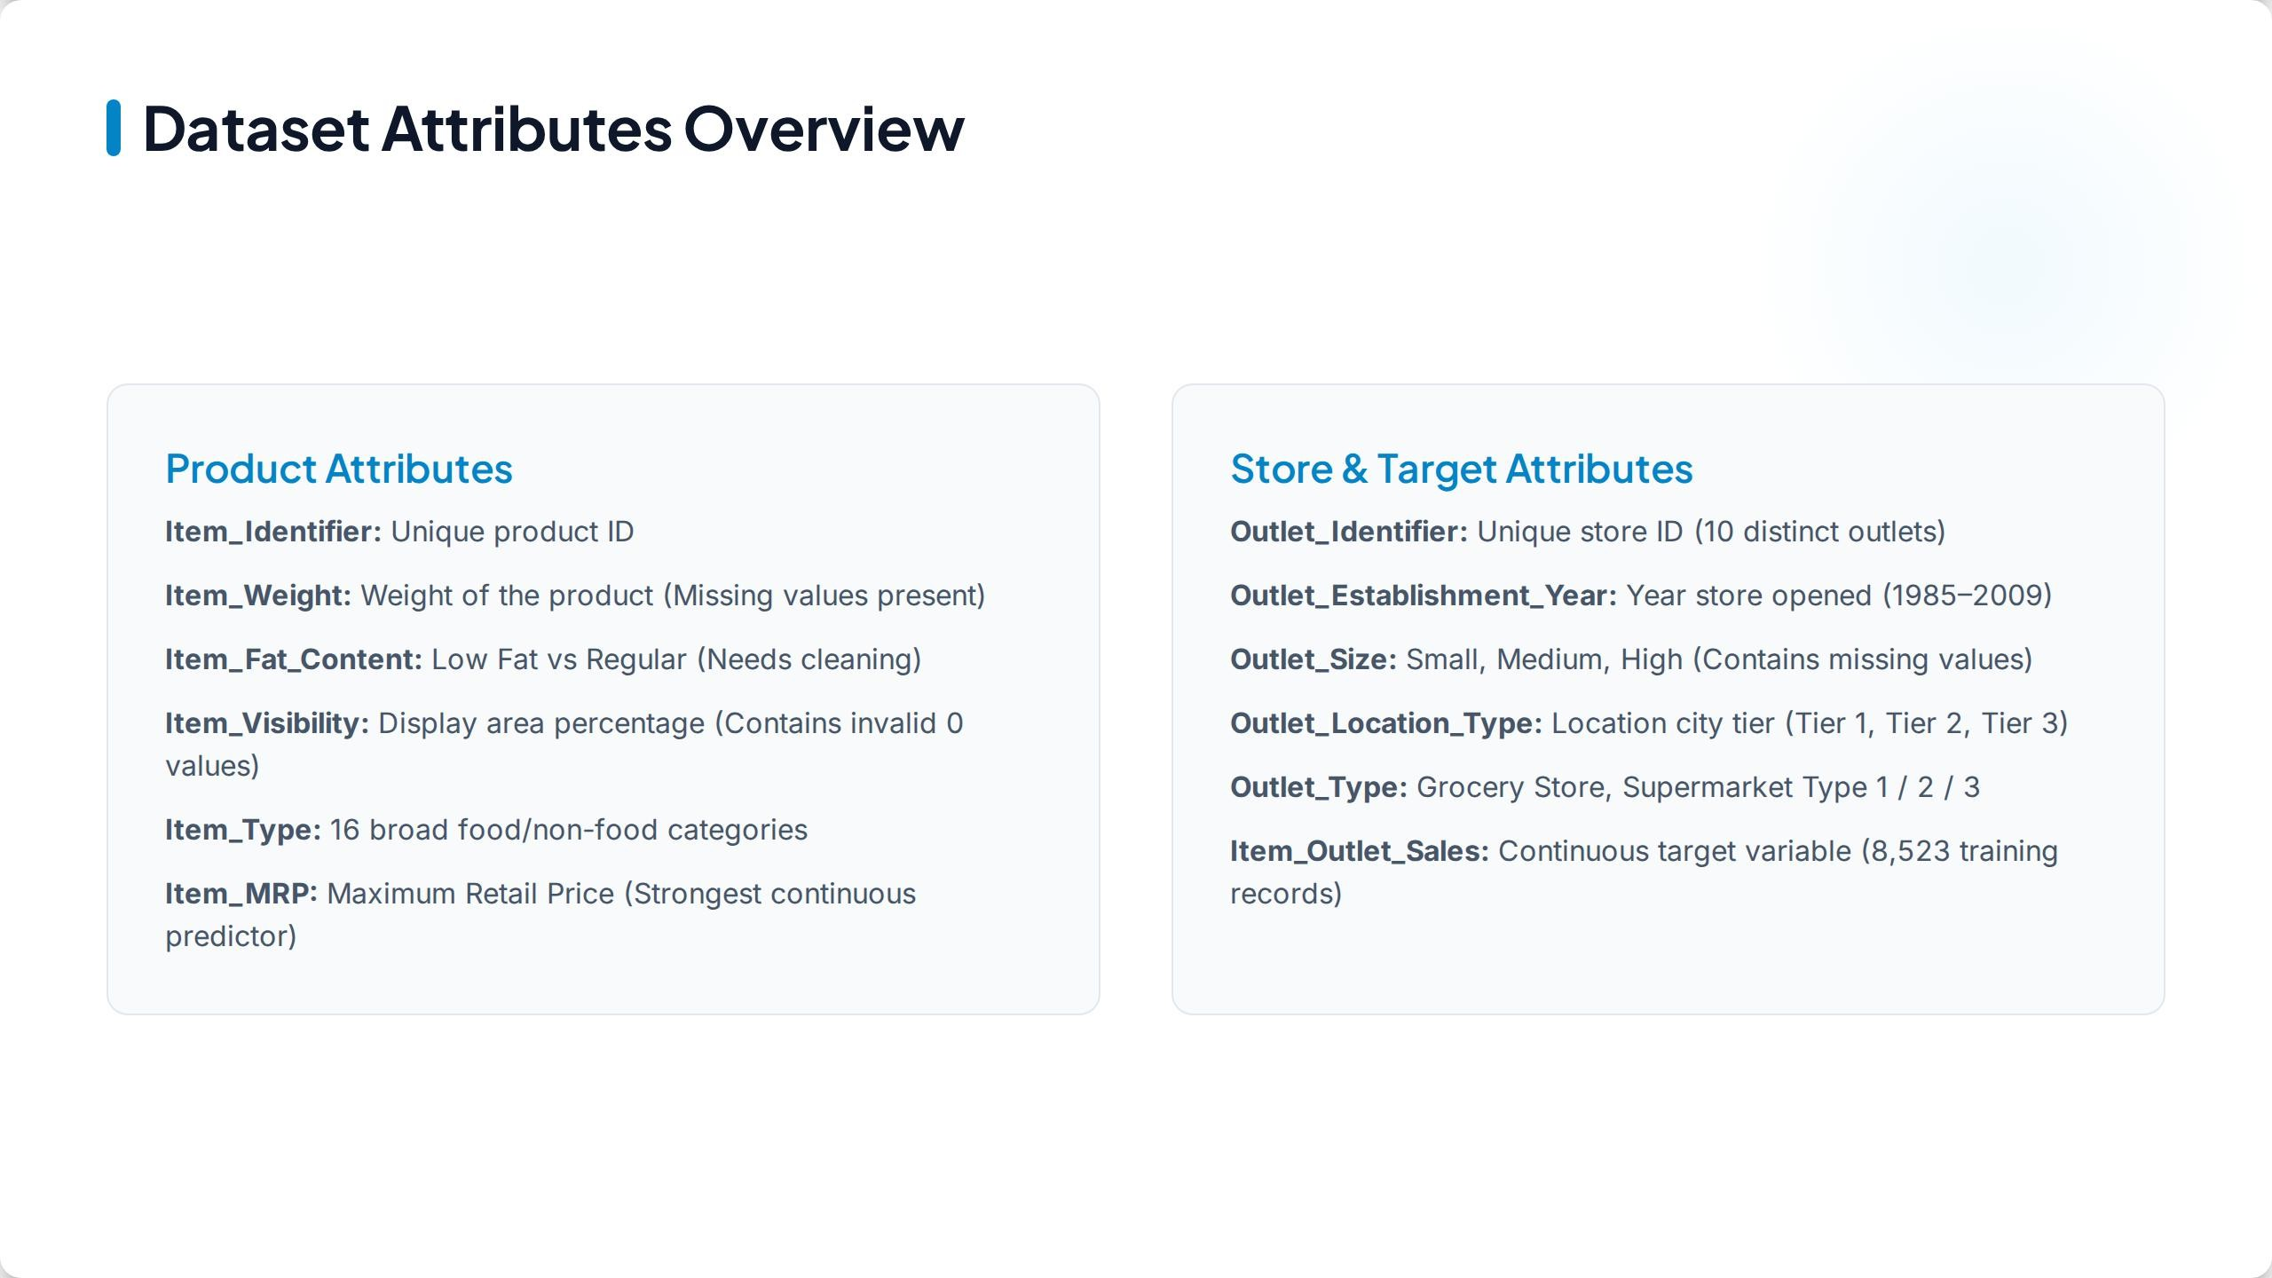

Slide 4
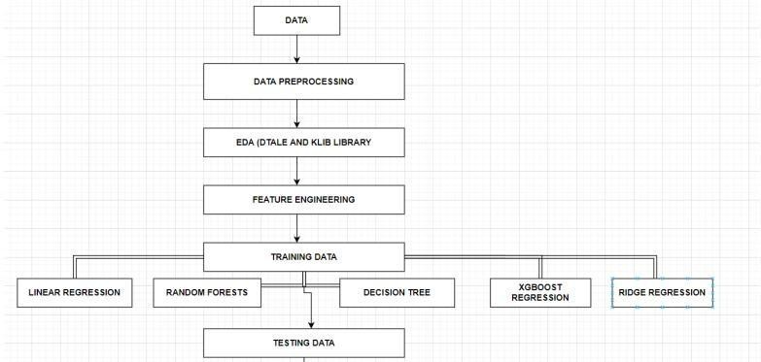
  METHODOLOGY

Slide 5
    Data collection- The step of every project is to collect the data.
We collected our data from the Kaggle whose link is given below-
https://www.kaggle.com/brijbhushannanda1979/bigmart-sales-data/code
    Data preprocessing-In this step we basically clean our dataset for example check for any missing value in the dataset , if present then handle the missing values. In our dataset attributes like Item Weight and Outlet Size had the missing value.
    EDA-This part is considered as one of the most important parts when it comes to data analysis. To gain important insights of our data one must need to do exploratory data analysis. Here in our project we used two libraries i.e. Matplotlib and Seaborn library.
    Tested various algorithms-Then various algorithms like simple LR, xgboost algorithm were applied in order to find out which algorithm can be used to predict the sales.
    Building the model -After completing all the previous phases which are mentioned above, now our dataset is ready for further phases that is to build the model.

Slide 6
Exploratory Data Analysis (EDA)
Distribution of Item Outlet Sales plotted –shows that the data is heavily right skewed Distribution
Feature Distribution Anomalies : Histograms and
Box Plots of Item visibility and item weight
Insight: item visibility is heavily right skewed and contains extreme outliers and there are 526 values as o
Insight: item weight shows a uniform distribution but contains a heavy concentration of missing values that must be imputed ,also in outlet size there are missing values

Slide 7
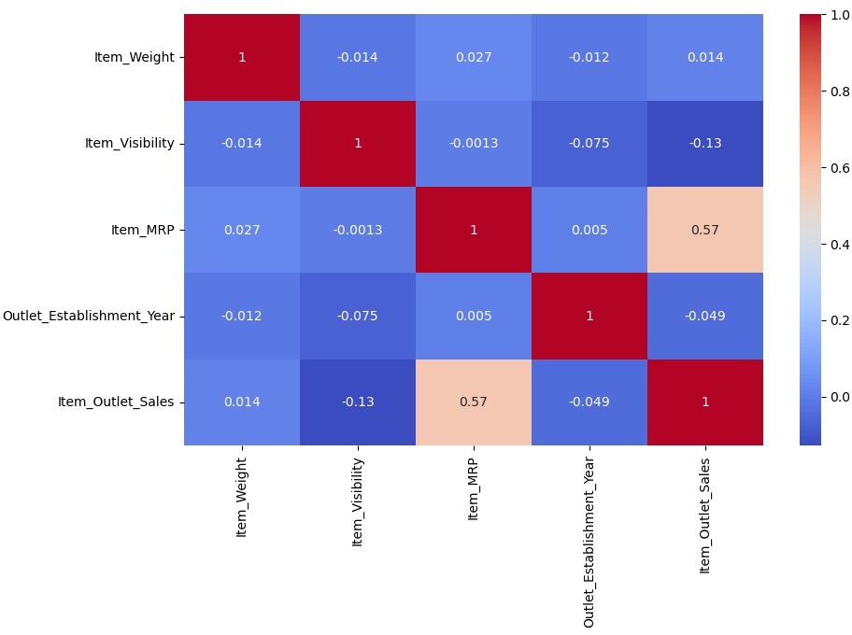
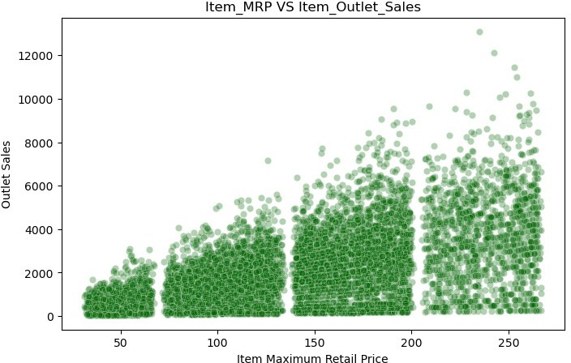
Bivariate Analysis
Scatter plot of item mrp and item outlet sales
Insight: item mrp has strong positive correlation with the sales . The scatter plot reveals distinct price bands showing that products are priced in tiers

Slide 8
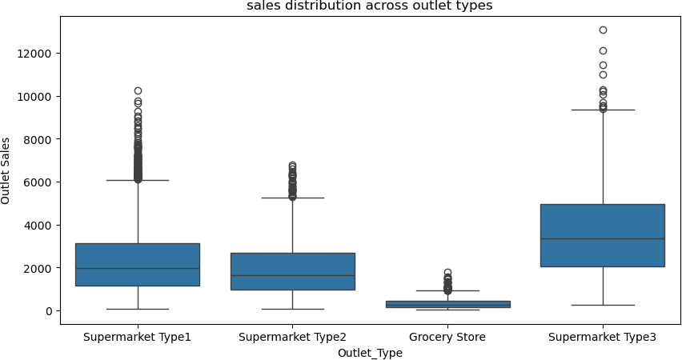
Box Plot of Outlet Types
Insight: shows that supermarket 3 has significantly higher median sales compared to grocery store which perform poorly
Proves that the specific environment where a product is sold matters just as much as the product price itself

Slide 9
Data Cleaning and preprocessing
Handling the missing values
For the item weight missing values they are filled with corresponding item identifier mean
For the outlet size missing values they are fill with corresponding outlet type mode
Fixing inconsistent Categories in item fat content
Mapped the inconsistent lf, low fat,reg to Low Fat and Regular
The handled the zero values in item visibility by
First the zeros are converted to ‘Nan’ and then filled the null values with the corresponding item identifier mean

Slide 10
FEATURE ENGINEERING
Created 2 new columns New Item type, Outlet years,
New item type is created by extracting first two letters of the item identifier FD, DR,NC
Then Mapped these items as Food , Drinks and Non consumable
Outlet years is calculated by subtracting the current year(2026) with outlet establishment year this will give how many years has this store been open
Locating NC in the new item type and and replacing them as Non Edible ,in the item fat content, because Non Consumable items like household cleaners or tissues were mistakenly labeled as low fat so creating new category called non edible

Slide 11
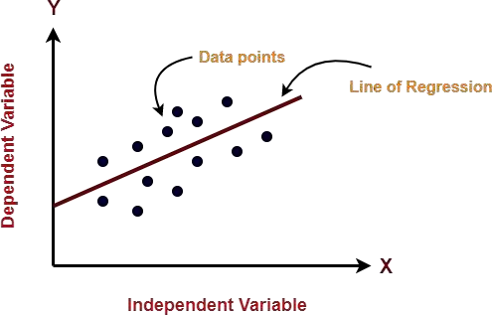
  ALGORITHMS EMPLOYED
    LINEARREGRESSION(LR)
As we know Regression can be termed as a parametric technique which means we can predict a continuous or dependent variable on the basis of a provided datasets of independent variables.
The Equation of simple LR is:
Y=βo+β1X+∈ (1)
where,
Y:It is basically the variable which we used as a predicted value. X : It is a variable(s) which is used for making a prediction.
βo:It is said to be a prediction value when X=0.
β1: when there is a change in X value by 1 unit then Y value is also changed. It can also be said as slope term ∈

Slide 12
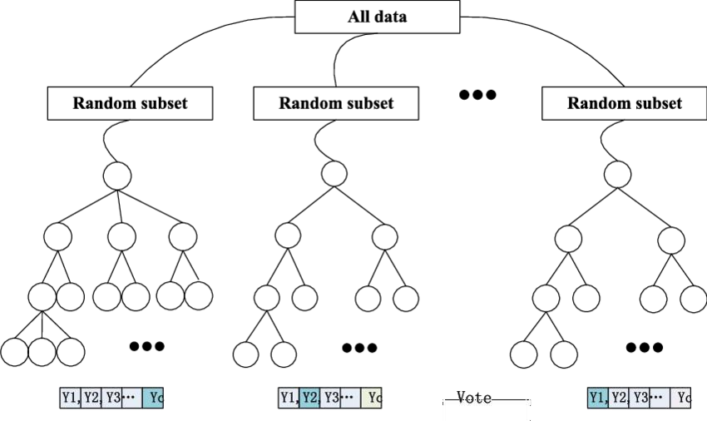
    RANDOM FOREST REGRESSION
Random Forest is a tree-based bootstrapping algorithm based on that tree that includes a certain number of decision trees to build a powerful predictive model. Individual learners, a set of random lines and a randomly selected few variables often create a tree of choice. The final prediction may be the function of all predictions made by each learner. In the event of a regression. The final prediction may be the meaning of all the predictions.

Slide 13
XGBOOSTREGRESSION
XGBoost stands for eXtreme Gradient Boosting. The implementation of an algorithm designed for the efficient operation of computer time and memory resources. Boosting is a sequential process based on the principle of the ensemble. This includes a collection of lower learners as well improves the accuracy of forecasts. No model prices n heavy for any minute t, based on the results of the previous t-speed. Well-calculated results are given less weight, and the wrong ones are weighed down. With this algorithm system
The XGBoost model uses stepwise, ridge regression internally, automatically selecting features as well as deleting multi co linearity.

Slide 14
Hyperparameter Tuning
Selected Algorithm : XGBoost Regressor
Search Methodology : RandomizedSearchCV
Validation: 5 fold cross validation
Parameters used: n_estimators(no of sequential trees), learning rate(step size shrinkage to prevent over fitting), max_depth(maximum depth of individual trees), subsample, colsample_bytree
Reason for choosing:
Xgboost : Has most interacting parameters ,trees are built sequentially also it catches complex retail relationships.
Linear Regression : zero parameters to tune
Lasso regression: only one parameter to tune(alpha)
Decision tree : very few parameters tuning them causes under fitting
Random forest: has parameters(n estimators, max depth) but builds trees independently ,default settings are already stable

Slide 15
Model Building and Evaluation
Linear Regression Model
r2_score= 51.79 %
Mean Squared Error (MSE)= 1310432.95
Root mean Squared error (RMSE)= 1144.74
Ridge Regression Model
r2_score= 51.79 %
Mean Squared Error (MSE)= 1310413.43
Root mean Squared error (RMSE)= 1144.73
-Random Forest Regressor Model
r2_score= 56.85 %
Mean Squared Error (MSE)= 1172866.36
Root mean Squared error (RMSE)= 1082.99

Slide 16
Model Building and Evaluation
XGBRegressor Model
r2_score= 61.44 %
Mean Squared Error (MSE)= 1048139.47
Root mean Squared error (RMSE)= 1023.79
r2_squared_train= 61.03 %
mean absolute error: 723.47
Best parameters: subsample': 0.9, 'n_estimators': 300, ‘ max_depth': 4, 'learning rate': 0.01, 'colsample_bytree': 1.0
Best Model cross Validation: accuracy of the model = 59.75%
array([0.60556101, 0.58768629, 0.58010302, 0.60803805, 0.60627381])
Lasso Regression Model
r2_score= 51.88 %
Mean Squared Error (MSE)= 1307998.64

Slide 17
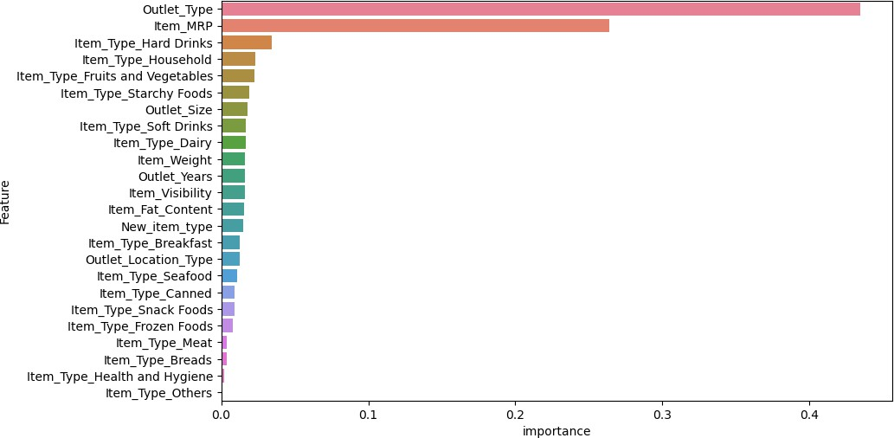
Feature Importance Analysis
Primary drivers: Outlet type, Item mrp

Slide 18
Feature Importance Analysis
Why item mrp wins: because total sales are measured in rupees Naturally higher priced items generate large revenue spikes making item mrp the strongest predictor
Outlet type wins: a products weight or its fat content does not matter if it is placed in a small, low-traffic grocery store
Our model reveals that the specific category of a product whether its dairy , soft drinks, or snacks has no impact on overall sales compared to the store type and price
A popular item will sell well regardless of its specific food item sub type
Features like outlet size and item visibility provide a stable , moderate impact on predictions.

Slide 19
Conclusion
It has been observed that increased efficiency is observed with XGBoost algorithm with lower RMSE, MSE and MAE rating and higher R2 rating
So from this project we conclude that a smart sales forecasting program is required to manage vast volumes of knowledge for business organizations.
The Algorithms which are presented in this report , LR, RF regression, Decision tree and XGBoost regression provide an effective method for data sharing as well as decision-making and also provide new approaches that are used for better identifying consumer needs and formulate marketing plans that are going to be implemented.
The outcomes of ML algorithms which are done in this project will help us to pick the for e most suitable demand prediction algorithm and with the aid of which Big Mart will prepare its marketing campaigns.

Slide 20
THANK YOU

